Slide 1
Foundations of Data Science & Analytics DSCI 633, Fall 2021
Lecture 24
(material sources cited in the last slide)
Nidhi Rastogi
Assistant Professor, GCCIS, RIT
November 23, 2021

Slide 2
Course Information
GitHub link - https://github.com/aiforsec/RIT-DSCI-633-FDS
For project related questions, reach out to the TA/ Instructor during office hours, via Slack, or email for any questions, suggestions, concerns, or general chat about data science.

Slide 3
Artificial Neural Networks (ANNs)

Slide 4
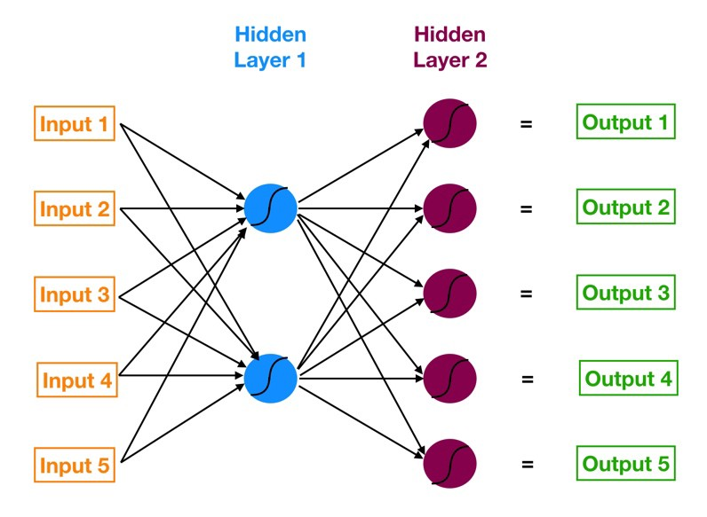
ANN
Neural networks are multi-layer networks of neurons (blue, red nodes)
Used for Classification, make predictions
ANN has 3 layers of neurons:
Input layer in orange
First hidden layer in blue
Second hidden layer in red
Output layer in green
Arrows:
Shows how neurons are interconnected
Direction of data flow from i/p to o/p layer
Neural network with two hidden layers

Slide 5
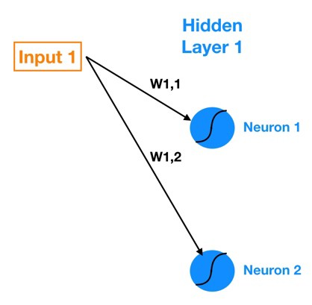
Not so simple ANN
Zooming into connections between Input 1 and Hidden Layer 1.
W_{1,1} : Weight that lives in connection between Input 1 and Neuron 1
W_{1,2} : Weight that lives in connection between Input 1 and Neuron 2
General notation: W_{a,b} is weight on connection between Input a (or Neuron a) and Neuron b.

Slide 6
Output for each Neuron
Computing Output of each neuron in Hidden Layer 1 (known as the activations):
Z1 = W1*IN_1 + W2*IN_2 + W3*IN_3 + W4*IN_4 + W5*IN_5 + Bias_Neuron1
where,
Neuron 1 Activation = Sigmoid(Z1)
W denotes weight, IN denotes input
Each neuron in the hidden layer has is own bias constant

Slide 7
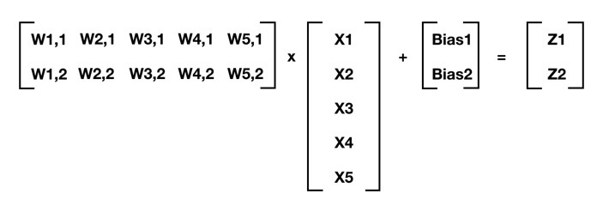
Output for each neuron (matrix)
In Matrix format,
Input 1
Input 2
Input 3
Input 4
Input 5

Slide 8
Output for each neuron (matrix)
In Matrix format,

Slide 9
Generalizing
In an ANN, Layer 1 has m Neurons. Next layer, Layer 2 has n Neurons
This generalizes to:
[W] . [X] + [Bias] = [Z]
where,
[W] is n x m matrix of weights of connections between previous and current layer
[X] is m x 1 matrix of either starting inputs or activations from previous layer
[Bias] is n x 1 matrix of neuron biases
[Z] is n x 1 matrix of intermediate outputs.
. denote matrix multiplication
Next, apply activation function (sigmoid in our case) to each element of [Z]
This gives us our neuron outputs (activations) for current layer

Slide 10
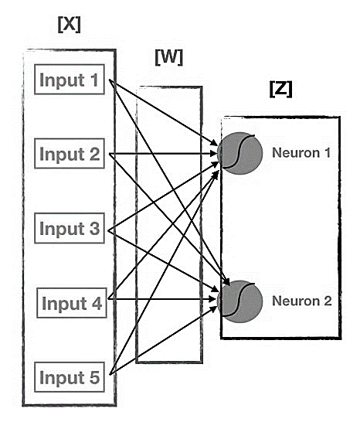
Simplifying Activation Function
Move from Input to Output:
- Repeatedly calculate [Z]
Apply activation function to [Z] for each successive layer
This process is known as Forward Propagation.
Visualizing [W], [X], and [Z]

Slide 11
Evaluating quality of Outputs Training ANN

Slide 12
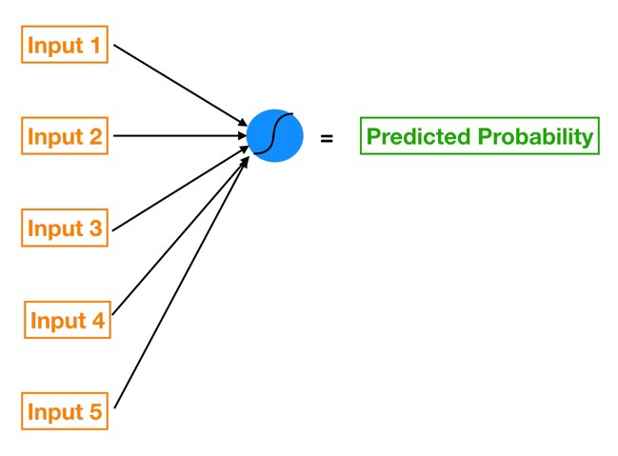
Training ANN
Objective: Given a set of training inputs (our features) and outcomes (the target we are trying to predict):
Find the set of weights and biases that minimize the cost function
where, cost function is an approximation of how wrong our predictions are relative to target outcome.
Notes:
Find the set of weights and biases that minimize the cost function
where, cost function is an approximation of how wrong our predictions are relative to target outcome.

Slide 13
Cost Function
Cost Function : Mean Squared Error (MSE)
MSE = Sum [ ( Prediction - Actual )² ] x (1 / num_observations)
Which cost function for ANN?

Slide 14
Gradient Descent (GD)
For ANN, to minimize cost function – use gradient descent
Notes:
Pre-requisite:
know gradient of cost function
vector that points in the direction of greatest steepness (we want to repeatedly take steps in the opposite direction of the gradient to eventually arrive at the minimum)

Slide 15
Challenge with using GD in ANN
Changeable weights and biases that are all interconnected
How to calculate gradient in this scenario?

Slide 16
Computing Cost Function for ANN
Compute gradient of our “current location” (calculate the gradient using current parameter values)
Modify each parameter by an amount proportional to its gradient element and in opposite direction of its gradient element.
Example, if partial derivative of our cost function with respect to
B0 is positive but tiny, B1 is negative and large
→ decrease B0 by a tiny amount and increase B1 by a large amount to lower cost function.
Recompute gradient using new tweaked parameter values
Repeat previous steps until we arrive at minimum cost

Slide 17
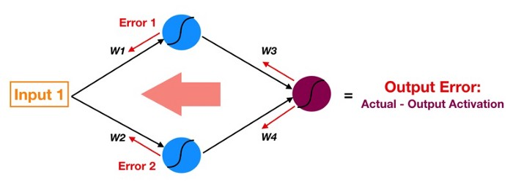
Backpropagation
- Reverse of Forward Propagation
- Except instead of signal, we are moving error backwards through our model.

Slide 18
Backpropagation
Follow red arrows –
- Start at output of red neuron - output activation (used for prediction) - the ultimate source of error in a model
- Move this error backwards through the model via the same weights and connections used for forward propagating the signal (instead of Activation 1, now we have Error1 — the error attributable to top blue neuron).

Slide 19
Discussion
Why is error for each neuron important?
2 building blocks of an ANN –
connections that pass signals into a particular neuron
(with a weight living in each connection)
Neuron itself (with a bias)
Tuning Parameters : weights and biases
Magnitude of error of a specific neuron is directly proportional to impact of that neuron’s output (a.k.a. activation) on cost function.

Slide 20
Challenges w/ increased complexity
vanishing gradients problem (or a related exploding gradients problem)
affects DNNs and makes lower layers very hard to train.
we might not have enough training data for such a large network, or it might be too costly to label.
training may be extremely slow.
a model with millions of parameters would severely risk overfitting the training set, especially if there are not enough training instances, or they are too noisy.

Slide 21
Gradient Descent
How to measure true impact of a first layer parameter’s variation on the final loss knowing this change affects all neurons in successive layers too?

Slide 22
Gradient Descent - BP
Back-propagation (or backward propagation)
Algorithm starts by calculating the partial derivatives of the loss function with respect to the parameters of last layer
Parameters of last layer don’t influence over any other network parameters. This isn’t a complicated calculation thanks to the chain rule (next slide).
Once derivatives are obtained, we move on to the previous layer, and we calculate the partial derivatives of the loss function, but now with respect to the parameters of this layer. Already partly solved thanks to chain rule.
Continue progressing backwards, until we reach the beginning of the network.

Slide 23
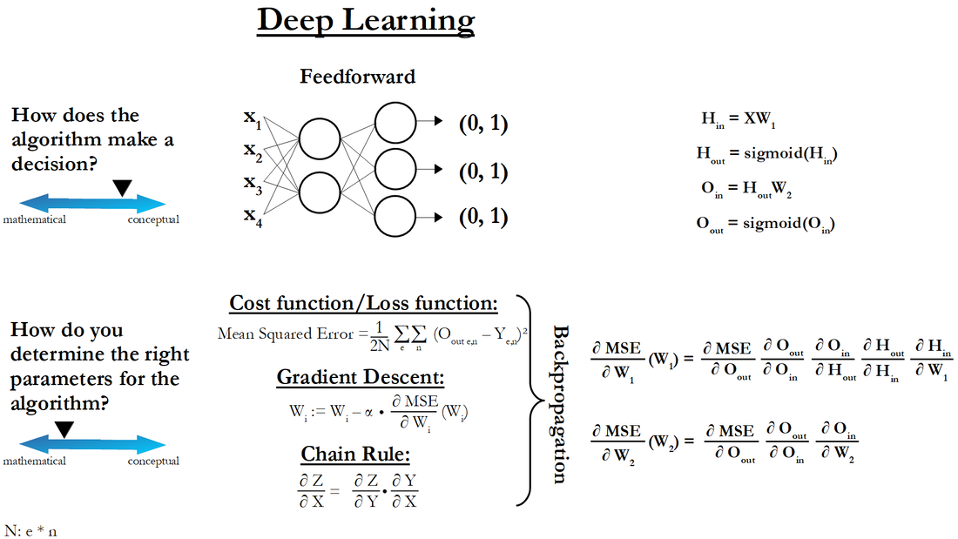
Chain Rule
Chain rule

Slide 24
Gradient Descent - BP
Update network parameters
subtracting corresponding gradient value from their current values, multiplied by a learning rate.
adjust magnitude of steps
Repeat until loss value and output metrics don’t start to steadily worsen

Slide 25
Note on Overfitting
Train for too many epochs (an epoch is a full cycle of the algorithm in which the network sees all available samples once).
Very high epochs implies -> same samples processed too many times causing overfitting
Cause: small dataset compared to network size OR learning rate too small not allowing optimization of parameters quickly enough.
Notes:
Cause: small dataset compared to network size (if the number of training samples is much smaller than the number of parameters or degrees of freedom in the network), but also by a learning rate being too small and not allowing us to optimize the parameters quickly enough.

Slide 26
Vanishing/Exploding Gradients Problems
Vanishing Gradients: When gradients get increasingly smaller as the algorithm progresses down to the lower layers.
Exploding Gradients: When gradients get increasingly large as the algorithm progresses down to the lower layers.
Useful sources:
https://stats.stackexchange.com/questions/432300/help-understanding-vanishing-and-exploding-gradients
https://www.analyticsvidhya.com/blog/2021/06/the-challenge-of-vanishing-exploding-gradients-in-deep-neural-networks/
https://www.youtube.com/watch?v=qss30DuhbCo&ab_channel=intrigano
https://towardsdatascience.com/activation-functions-b63185778794

Slide 27
Vanishing/Exploding Gradients Problems
>> What this means for the weights?
>> GD update leaves weights of lower layer connections unchanged, and training never converges to a good solution. This is called the vanishing gradients problem.
For Exploding Gradients: Gradients can grow bigger and bigger, so many layers get insanely
large weight updates and the algorithm diverges.
More generally, deep neural networks suffer from unstable gradients; different layers may learn at
widely different speeds.

Slide 28
Glorot and He Initialization
Paper proposed a way to significantly alleviate this problem. How?
signal should flow properly in both directions: forward direction when making predictions, and reverse direction when backpropagating gradients
We don’t want signal to die out, nor do we want it to explode and saturate

Slide 29
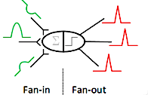

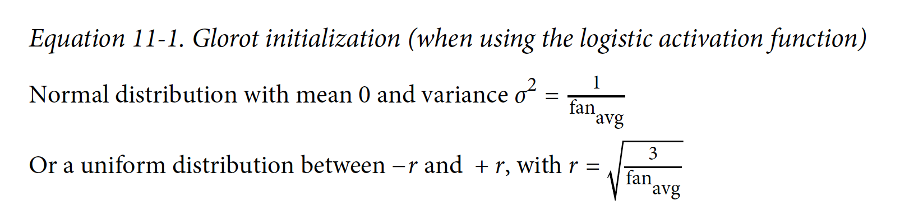
Glorot and He Initialization
Signal should flow in both directions
variance of outputs of each layer to be equal to the variance of its inputs
gradients to have equal variance before and after flowing through a layer in the reverse direction
Note: Not possible to guarantee both unless the layer has an equal number of inputs (fan-in) and neurons.
Solution worked very well in practice. See equation.

Slide 30
Glorot and He Initialization
Using Glorot initialization can speed up training considerably

Slide 31
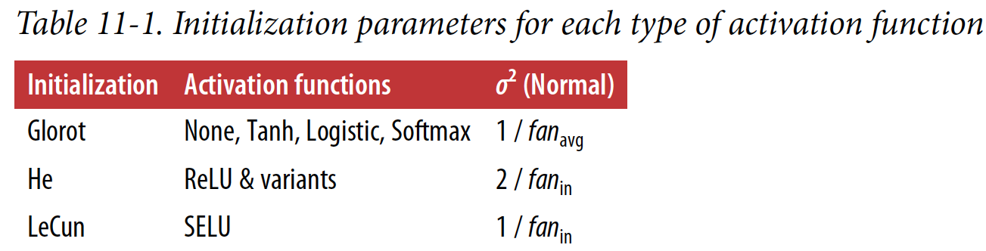
Other activation functions
Strategies differ only by scale of the variance and whether they use fan_{avg} or fan_{in} (see Table)
- initialization strategy for ReLU activation function sometimes called He initialization (after
the last name of its author).

Slide 32
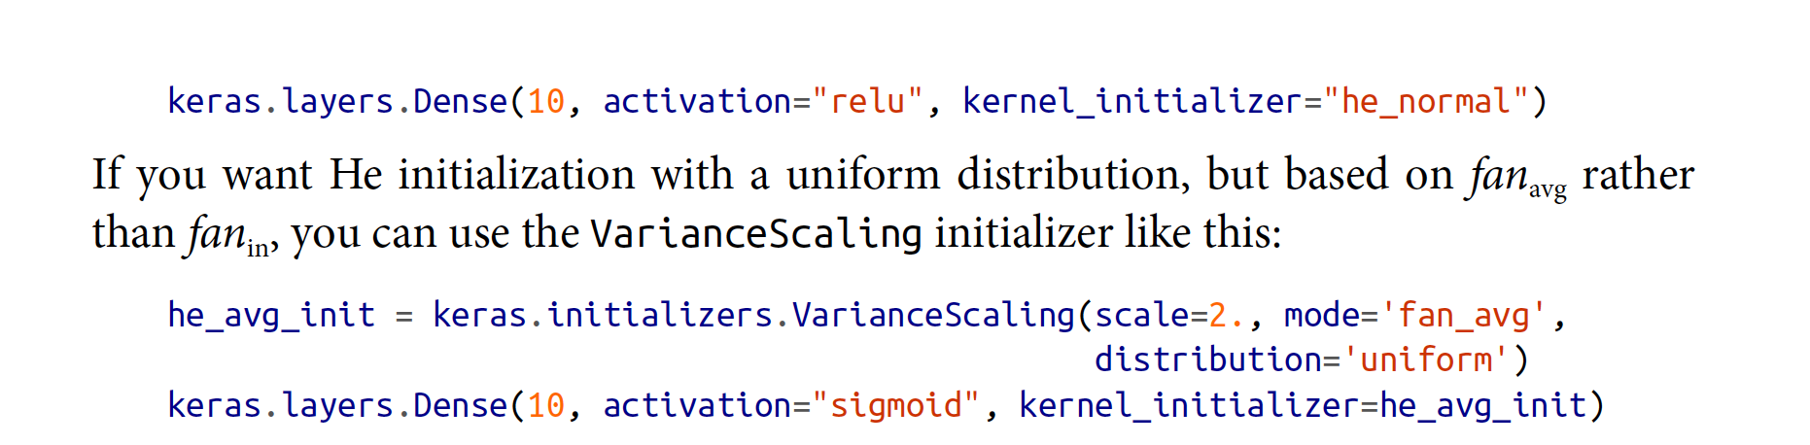
In Practice
By default, Keras uses Glorot initialization with a uniform distribution. You can
change this to He initialization by setting kernel_initializer="he_uniform" or ker
nel_initializer="he_normal" when creating a layer, like this:

Slide 33
ReLU
ReLU activation function works better than He :
it does not saturate for positive values (and also because it is quite fast to compute)
Challenges with ReLU
during training, some neurons effectively die, meaning they stop outputting anything other than 0
Dying ReLUs

Slide 34
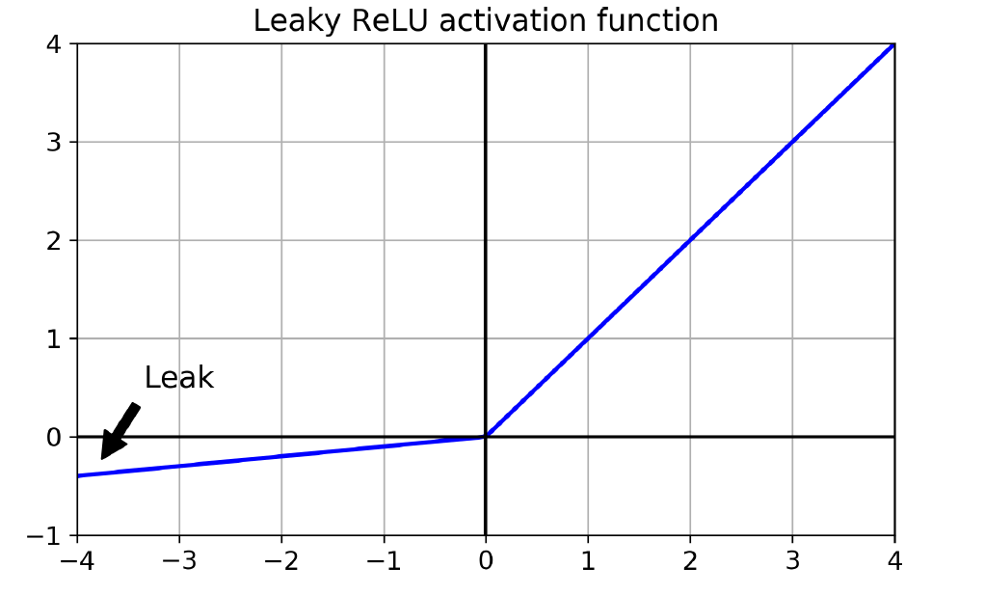
Leaky ReLU
To solve this problem, use a variant of the ReLU function - leaky ReLU
LeakyReLU_{α}(z) = max(αz, z)
α – hyperparameter that defines how much the function “leaks”
- it is the slope of the function for z < 0
- typically set to 0.01
Small slope – ensures that leaky ReLUs never die

Slide 35
Faster Optimizers
Training DNN can be very slow process.
4 Ways we’ve seen to speed it up:
applying a good initialization strategy for the connection weights
using a good activation function
using Batch Normalization, and reusing parts of a pretrained network (possibly built on an auxiliary task or using unsupervised learning)
.. Faster optimizers
Faster Optimizers are Faster than regular GD optimizer

Slide 36
Faster Optimizers
Optimizers define the change in weights or learning rates of your neural network to reduce the losses

Slide 37
Faster Optimizers
Faster than regular GD optimizer
Different Types:
Momentum optimization
Nesterov Accelerated Gradient
AdaGrad
RMSProp
Adam and Nadam optimization.

Slide 38
Variations of Gradient Descent (review)
algorithm: θ=θ−α⋅∇J(θ)
SGD: θ=θ−α⋅∇J(θ;x(i);y(i)) ,
where {x(i) ,y(i)} are the training examples.
Mini-batch GD: θ=θ−α⋅∇J(θ; B(i)),
where {B(i)} are the batches of training examples

Slide 39
Avoiding Overfitting
Through Regularization
l1 and l2 Regularization
Dropout
Monte-Carlo (MC) Dropout
Max-Norm Regularization

Slide 40
Regularization
Controls model complexity
by adding a penalty for higher terms.
Normally, model aims to minimize loss according to loss function.
Regularization adds a term so that model minimizes both complexity and loss.

Slide 41
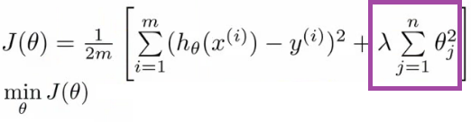
Regularization
Term added

Slide 42
Regularization Techniques
Regularization reduces complexity by using
l1 and l2 technique
Dropout
Max-norm regularization (self study)
But first, how is complexity added?

Slide 43
Complexity in a model
Total number of features
The weights of features

Slide 44
Regularization
Regularization reduces complexity by using
l1 and l2 technique
Dropout
Max-norm regularization (self study)
But first, how is complexity added?

Slide 45

L1 regularization
L1 regularization - handles complexity due to total number of features.
acts like a force that subtracts a small amount from weights at each iteration.
some weights eventually become zero.
also called lasso regularization

Slide 46

L2 regularization
L2 regularization - handles complexity due to magnitude of feature weights.
acts like a force that removes a small percentage from weight at each iteration.
weights decrease but never become zero
Also called ridge regularization

Slide 47

l1 and l2 Regularization
Apply l2 regularization to a Keras layer’s connection weights, using a regularization factor of 0.01

Slide 48
Regularization
Regularization reduces complexity by using
l1 and l2 technique
Dropout
Max-norm regularization (self study)
But first, how is complexity added?

Slide 49
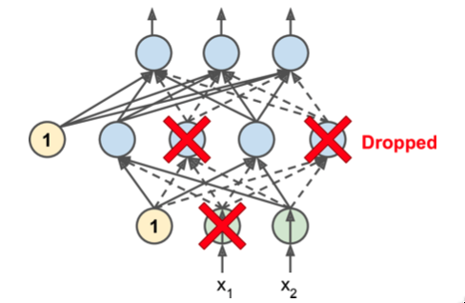
Dropout - Algorithm
at every training step, every neuron (including input neurons, always excluding output neurons) has a probability p of being temporarily “dropped out”,
dropped neuron entirely ignored during this training step
it may be active during next training step
hyperparameter p
called dropout rate
typically set to 50%.
after training, neurons don’t get dropped
anymore.

Slide 50
Coding

